Slide 1

What is Information Technology?
Professor Rieks
Fall 2022

Slide 2
When you hear “IT” what comes to mind?
???
Information Technology
Computerized systems consisting of hardware, software and/or networks intended for the storage, retrieval, processing, and transmission of data and information, usually within an organizational or business context.
Notes:
Write your student’s answers into the space provided and discusss them

Slide 3
What about the following?
“Consumer IT”
“Enterprise IT”

Slide 4
Take a minute to think of an information technology. It can be something you use every day or something you’ve heard of before.
What is it? What does it do?
Is it hardware, software, or both?
Is it consumer IT, enterprise IT or both?
You will be asked to share your answers with the class.

Slide 5
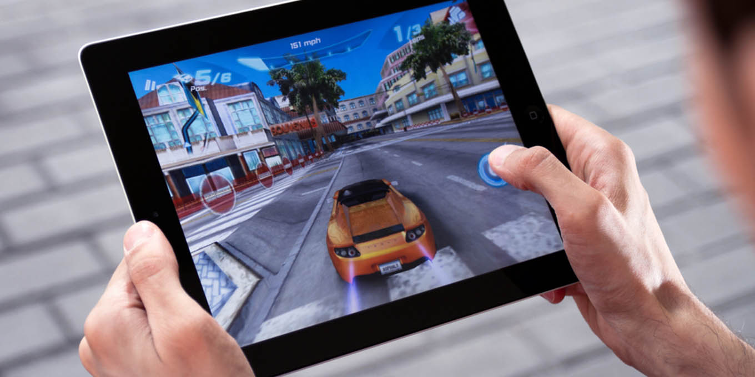
Notes:
A person playing a game on a tablet computer. If this information technology?

Slide 6
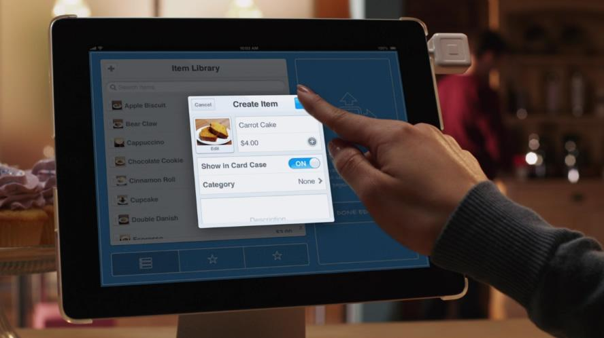
Notes:
A screen shot of a person using a tablet computer in an information technology context.

Slide 7
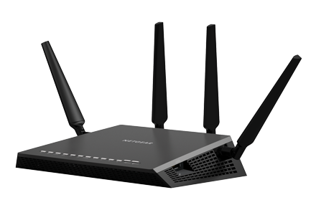
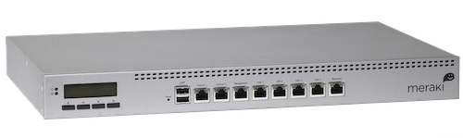

Slide 8
Notes:
Screen shot of google email service gmail. Is this consumer IT or enterprise IT?
The lines are blurred. Gmail started out as consumer IT and now has grown to enterprise IT as well. Many organizations trust gmail to run the email for them!

Slide 9
How is consumer IT Managed?
Have you reset your home router?
Does your Thanksgiving consist of “fixing” your parents’ computer?
When there’s an issue with your phone or TV, do you Google how to fix it?
Consumer IT is not managed in an organized fashion because
Consumer IT is not mission critical.

Slide 10
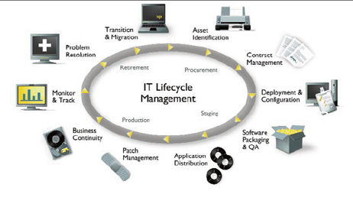
Enterprise IT Management Is Organized
Runs the business.
Needs to be reliable and stable.
Many methodologies exist.
Notes:
Briefly explain the IT lifecycle

Slide 11
Who Manages Enterprise IT?
Entry Level
IT Support Technician
Systems / Network Administrator
Web / Application Developer
Mid-Level
IT Analyst
IT Architect
IT Project Manager
Senior
Directors / Officers in an area Data, Secuirty
Enterprise Architect
CTO, CDO, CIO

Slide 12
The IT Job Title-O-Matic
Pick a Domain…
Then Pick a Role…
Systems
Network
IT
Database
Web
Operations
Business Process
Enterprise Systems
Information Security
Operator
Technician
Developer
Administrator
Engineer
Director
Specialist
Architect

Slide 13
Essential Skills of the IT Professional
Technical Knowledge
1
Customer Focused
2
Creative Thinking / Problem Solving
3
Understanding of the business
4
Time Management
5
Notes:
Technical Knowledge – you don’t have to be the best techie and know every little command, but you do have to understand how it works so that you can manage it.
Customer Focused – this is a customer focused job that is done for people
Problem Solving – Your career will skyrocket if you can devise creative solutions to difficult or costly problems
Understanding the business - You cant manage what you do not understand
Time management – you will get pulled in a lot of directions

Slide 14
IT Skills Assessment Group Exercise
Get into groups of 3. Each of you should take out a piece of paper.
Inventory the skills within your IT Team.
On a scale from 0 to 10, where 0 is not at all and 10 is expert individually rate your IT skills. E.g. Technical Knowledge = 3. be honest!
Compare your skills with your group mates and select the highest skill among your group.
Report your scores to the class. You have 15 minutes
Technical Knowledge
1
Customer Focused
2
Creative Thinking / Problem Solving
3
Understanding of the business
4
Time Management
5
Notes:
When my new IT Director was hired at the company for which I was a Support Technician, this was one of the first exercises she made us do to inventory the skills of our IT team. This helped us to identify our strengths and weaknesses as an individual and as a group. We found out quickly we were not very customer focused and it served as a point of emphasis among our team!

Slide 15
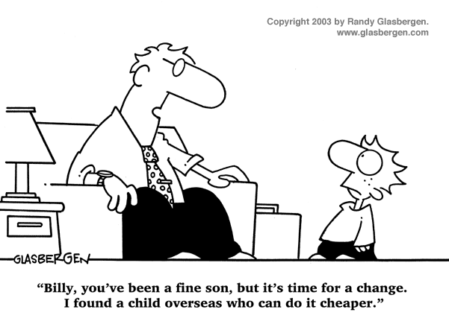
Managing IT

Slide 16
Information Technology Management
The process of overseeing the systems, services, people resources, and processes within an IT organization.
Managing IT: Mission Impossible?
Keeping essential services operational, while trying not to work 24x7x365.
Providing people access to the resources they need, but not access to the resources they don’t.
Keeping internal costs down, but productivity up.
Fixing problems reported by end-users, with a keen eye towards strategic planning.
Managing the work and keeping everyone happy. ☺

Slide 17
Manage The Work
Operational
Do Not Get So Bogged Down in the Operational That you Neglect Strategic Work!
Problems / Issues
Feature Requests
Training End-Users
Maintenance / Patches / Upgrades
Strategic
Migrations to new Platforms
Identifying Black Holes / Time Drains
Alignment with Organizational Strategy
Innovation
Notes:
Operational work is user-generated or system generated work. It is not strategic but commoditized.
- Problem and issues with systems, people or processed.
- Requests for new features or upgrades to software.
- Training / education
- Maintenance of systems such as patching software, replacing old hardware or freeing up disk space, etc.
Strategic work is game-changing. It drives innovation and makes IT a differentiator within your organization, saving people time and the organization money.
Migrations to new platforms or systems. Such as moving email to the cloud.
Identifying the problem or issues which consume the most time or resources
Aligning the IT with the strategy within the organization
IT innovation. Generating new ways to leverage IT to improve the way the organization works.

Slide 18
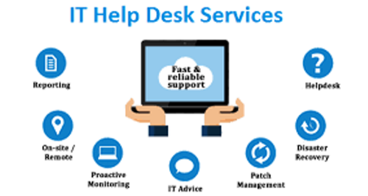
Helpdesks
The “public face” of your organization
Interaction with end-users (customers).
Helpdesk should be a friendly, pleasant experience.
Define hours of operations and have instructions for what your customers can do and expect off-hours.
A Helpdesk generates operational work in progress
Strategic managers use helpdesk data to demonstrate where time is spent, identify black holes and drive IT innovation.

Slide 19
Managing Operational Work
Track ALL Operational Work in a system.
Use A Ticketing System to track work.
End-Users file requests, or they are logged through the helpdesk.
A Triage process assigns work to those qualified to complete it and prioritizes it.
Use A Kanban board to manage the work
Helps to organize what should be done when as there is only a finite number of hours in the week.
Notes:
I used to have

Slide 20
IT Services Models
Centralized – One service is managed and supported across the entire enterprise.
Distributed – One service is managed and supported by individual units with the enterprise.
Decentralized – Multiple iterations of the same service are managed and supported by individual units within the enterprise.

Slide 21
Centralized vs Decentralized
Centralized
Decentralized
Economies of Scale – improved efficiencies and reduced costs.
Encourages specialization among IT staff as they become proficient in managing at scale.
Faster response times and more agility.
No single point of failure within a service.
More flexible to user needs.
Core infrastructure services should be centralized.
Services strategic to the operations of a unit should be decentralized.
What’s Centralized here and whats Decentralized?

Slide 22
TCO: Total Cost of Ownership
TCO a calculation designed to help managers assess the economic value of an investment through its cost.
In the IT world, your investment is typically a service or asset.
TCO is a useful way to compare similar investments.
TCO calculations consist of both direct and indirect costs
Direct Costs: Are directly accountable to the investment. Eg. Hardware, Software, Operation, and Admin. Costs
Indirect Costs: Are not directly accountable to the investment. Eg. End user operations (support), Downtime, Loss of Productivity, Switching Costs
Notes:
Direct Costs are the costs you can budget and measure.
Indirect Costs are costs of running helpdesks, the costs of users who support themselves and others, and downtime

Slide 23
TCO Example – Indirect cost comparison
I can host my Wordpress Blog:
On wordpress.com for $48/year. TCO₁
Or in my basement on an old PC for “free” (let’s assume electricity costs add up to about $35/year. TCO₂
TCO₁=$48 + Indirect Costs₁ TCO₂=$35 + Indirect Costs₂ $48 + Indirect Costs₁ == $35 + Indirect Costs₂ $8 + Indirect Costs₁ == Indirect Costs₂
TCO₁ Costs $8 more than TCO₂, but who supports Wordpress, Updates it, and deals with power outages as part of those indirect costs in TCO₂? Me.
Is my time worth more than $8 year? YES! Thus TCO₁ is lower.
Notes:
One way to use the TCO formula is to compare indirect costs.

Slide 24
ROI: Return on Investment
ROI is a type of calculation designed to help managers assess the economic value of an investment through its potential
ROI = (gain-cost)/cost
Example gain=$7,500 cost=$5,000 ROI=50%
Positive ROI is good, negative is bad.
ROI is used in IT to help compare similar IT investments.
In IT, typically ROI is calculated over the expected lifecycle of a system or over 3 years (average life expectancy)

Slide 25
ROI Example: Selling Products on the Web
You work for a parts distributor. Currently you do not sell products on line.
A recent TCO study has revealed it will cost $12,000/year to begin selling products on the web.
If you would like a 25% ROI, what is the expected gain?
If another option is to partner with Amazon.com to sell your parts on line at a cost of $5,000/year What is the expected gain for the same 25% ROI? Is it better?
If the marketing department claims that by spending $5,000 next year on local advertising they can generate an additional $9000 in additional sales.
Which option has the best ROI?

Slide 26
ROI Example: Selling Products on the Web
.25 = (gain – 12000)/12000 3000 = gain-12000 gain = 15000
.25 = (gain – 5000)/5000 1250 = gain – 5000 gain = 6250
ROI = (9000-5000)/5000 ROI = 4000/5000 = .8
Option C has the highest ROI. In this example it is the best option.
Option A and B have the same ROI but option B has a lower TCO so…
Option B is better than option A

Slide 27

Check Yourself
Rieks CO. has determined that switching from in-house accounting to a cloud accounting system will save the company $5000 /year. If it costs, $2000 /year to host the cloud accounting system, what is the ROI?
It costs $2000 / year to host accounting in the cloud, but $5000 over 3 years to rent an appliance from the same company and store it in your data center. Assuming the same indirect costs, which has lower TCO?
Now do an indirect costs comparison. At which point is the other option viable?
Notes:
ROI = (gain – cost) / cost
ROI = (5000 – 2000) / 2000
ROI = 3000 / 2000
ROI = 150%
A = 2000 * 3 = 6000 over 3 years
B = 5000 over 3 years
B has lower TCO assuming identical indirect costs
In reality the indirect costs of option B need to be more than $1000 over three years for option A to be viable.

Slide 28

Questions

